Slide 1
Final project
Speaker Name:
Ameed Ghanem
Information security workshop
Tel Aviv University

Slide 2
Outline
IPS
- Command Injection
- Ajenti auth username Command Injection
DLP

Slide 3
Command Injection
Command injection is an attack in which the goal is execution of arbitrary commands on the host operating system via a vulnerable application.(by OWASP)
Command injection attacks are possible when an application passes unsafe user supplied data (forms, cookies, HTTP headers etc.) to a system shell.

Slide 4
Example
<?php
print("Please specify the name of the file to delete");
print("<p>");
$file=$_GET['filename']; system("rm $file");
?>
For the request http://127.0.0.1/delete.php?filename=bob.txt;id this will print out user and group names and numeric ID's (UID or group ID) of the current user or any other user in the server

Slide 5
Ajenti auth username Command Injection

Slide 6
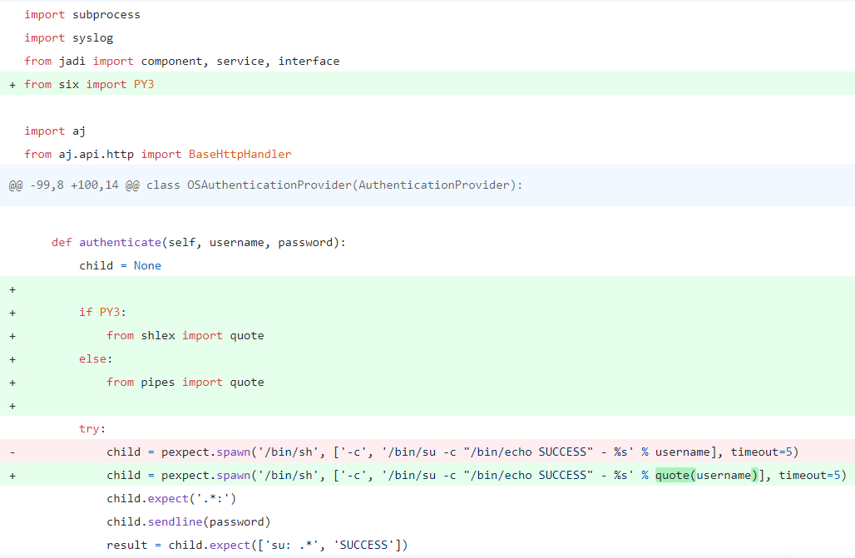
Vulnerability & Fixation

Slide 7
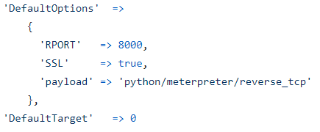
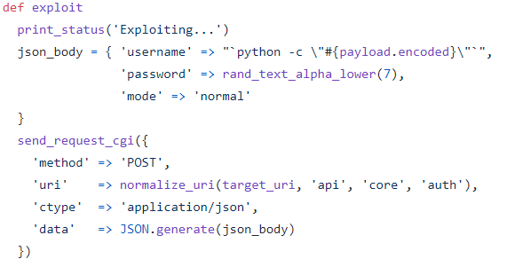
How the attack works

Slide 8
Cont.
In order to recognize an attack, I used input validation.
I simply defined a regular expression that described the expected username format.
If the validation failed I know then it’s an arbitrary code the attacker has sent.

Slide 9
Data leak prevention
I computed the following:
- the count of C keywords
- the count of library functions (e.g. strcmp, fopen, fclose, strlen…)
- the count of pointer types (e.g. void*, char*, char**, int*…)
- the count of popular header files (e.g. stdio.h, stdlib.h, string.h …)
I computed the sum of these numbers and validated the result is greater than or equal to 11% of the total words. (I assumed each keyword/library function appears maximum once in each line).

